Slide 1




COURSE FEEDBACK SENTIMENT ANALYSIS
USING ZOHO CREATOR
AI-Based Student Feedback Classification and Teacher-Wise Analytics
I. Mohammed Hamza
Bachelor of Engineering (B.E.)
Computer Science and Engineering
Third Year
Rajalakshmi Engineering College
LOW-CODE APPLICATION CREATOR USING ZOHO CREATOR
CB23F35

Slide 2







ABSTRACT AND PROBLEM STATEMENT
ABSTRACT
PROBLEM STATEMENT
Student feedback is crucial for enhancing teaching quality and driving academic improvement
Manual feedback analysis is
time-consuming
Manual analysis becomes difficult and inefficient when handling large volumes of feedback
Difficuly in identifying
sentiment efficiently
This project introduces a Zoho Creator application with built-in Zia AI Sentiment Analysis
Challenges in generating teacher-wise sentiment statistics manually
Feedback is automatically classified into
Positive, Negative, and Neutral
An administrator dashboard provides
teacher-wise sentiment insights
Need for a centralized
feedback analytics platform

Slide 3








OBJECTIVES AND SYSTEM COMPARISON
OBJECTIVES
EXISTING VS PROPOSED SYSTEM COMPARISON
EXISTING SYSTEM
PROPOSED SYSTEM
Automate sentiment classification of student feedback
Manual feedback analysis
Zoho Creator-based
feedback application
Use Zoho Creator's built-in Zia AI Sentiment Analysis
Generate Positive, Negative, Neutral classifications automatically
Time-consuming sentiment classification
Built-in Zia AI Sentiment classification
Provide teacher-wise sentiment statistics
Teacher-wise stats calculated manually
Automatic positive, negative, neutral generation
Display insights via dashboards and charts
Limited graphical representation
Teacher-wise statistical analysis
Reduce manual effort in feedback analysis
No AI sentiment classification
Interactive dashboards and reports

Slide 4


























SYSTEM ARCHITECTURE AND WORKFLOW
WORKFLOW OVERVIEW
Positive
01
Student selects teacher name
Neutral
02
Student selects course/subject name
Negative
03
Student enters feedback
in multiline text field
Student
Course
Feedback Form
Zoho Creator
Application
Built-in Zia AI
Sentiment Analysis
Automatic
Sentiment
Classification
04
Student submits feedback form
05
Zoho Creator's Zia AI automatically analyses feedback
06
Sentiment classified as
positive, negative, or neutral
07
Feedback and sentiment
stored in database
Feedback
Record Storage
Administrator
Dashboard
Teacher-Wise
Statistics, Charts,
and Reports
08
Administrator dashboard
updates statistics

Slide 5














MODULE DESCRIPTION AND AI IMPLEMENTATION
MODULE DESCRIPTION
AI IMPLEMENTATION DETAILS
ILLUSTRATIVE EXAMPLES
01
Student Feedback Submission
minimal form collecting teacher, course, feedback
Platform: Zoho Creator
“The teacher explains concepts clearly.”
Positive
02
Teacher and Course Management
AI Feature: Native Zia Sentiment Analysis field
maintains teacher and subject data
03
Built-in AI Sentiment Analysis
Input: Course feedback text
automatic classification using Zoho Creator's Zia AI
“The teaching is
confusing.”
Negative
04
Teacher-Wise Sentiment Statistics
Output: Positive, Negative, Neutral classification
counts positive, negative, neutral per teacher
05
Administrator Dashboard and Analytics
Sentiment auto-generated; no
manual dropdown
“The course is conducted twice a week.”
shows sentiment counts, charts, comparisons
Neutral
06
Feedback Reports and Filtering
No custom ML or external API used
filter feedback by teacher, course, sentiment

Slide 6






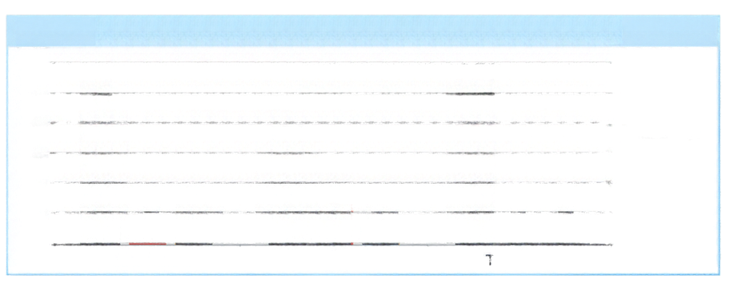
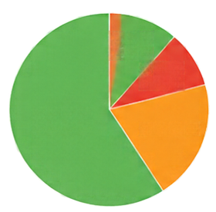

















ADMINISTRATOR DASHBOARD AND ANALYTICS
TOTAL FEEDBACK SUBMISSIONS
POSITIVE FEEDBACK COUNT
NEGATIVE FEEDBACK COUNT
NEUTRAL FEEDBACK COUNT
127
72
20
35
(56.7%)
(15.7%)
(27.6%)
OVERALL SENTIMENT DISTRIBUTION (ILLUSTRATIVE SAMPLE DATA)
TEACHER-WISE SENTIMENT COMPARISON (ILLUSTRATIVE SAMPLE DATA)
60
50
40
30
20
10
0
50
102%
45
15.7%
Positive (56.7%)
32
Positive
Neutral (27.6%)
Negative
56.7%
27.5%
Negative (15.7%)
10
12
Neutral
5
8
7
3
Teacher A
TEACHER-WISE FEEDBACK TABLE (ILLUSTRATIVE SAMPLE DATA – NOT ACTUAL RESULTS)
Teacher
Positive
Negative
Neutral
Teacher A
45
5
10
32
12
8
50
3
7
ILLUSTRATIVE SAMPLE DATA – NOT ACTUAL RESULTS

Slide 7










ADVANTAGES, FUTURE SCOPE, AND CONCLUSION
ADVANTAGES
FUTURE SCOPE
LIMITATIONS
Automatic sentiment classification
Semester-wise sentiment trend analysis
AI sentiment may not always be accurate
Minimal, user-friendly feedback form
Email notifications for negative feedback
Sarcasm and ambiguous feedback
can be misclassified
Reduced manual analysis effort
Topic extraction from comments
Teacher-wise statistical insights
Additional student rating fields
Dependent on built-in AI features only
Centralized feedback management
Multilingual sentiment analysis
when supported
Low-code development on Zoho Creator
CONCLUSION
The application provides an efficient way to analyze student feedback using Zoho Creator's Zia AI.
It automatically classifies feedback and supplies teacher-wise statistics.
This reduces manual work and helps institutions gain insights into teaching quality and satisfaction.
THANK YOU. QUESTIONS?

